Slide 1
This presentation, together with the next few presentations,
outline the procedures for measuring and calculating vertical
distances.
Accurately
It is important that we understand and always consider
the required and achievable accuracy.
Errors
Gross Errors
Systematic Errors
Random Errors
Precision - represents the repeatability of a measurement
and is concerned only with random errors.
Observations closely grouped together with a small deviation
from the sample mean (small standard error) are said to be
precise.
Notes:
Errors - This is a vast and very important aspect of surveying which we are only going to touch on. There are whole books devoted to the subject.
Gross errors - mistakes or blunders due to carelessness or incompetence. Incorrect use of equipment - incorrect booking (17.236 instead of 17.326) Our surveying programme aims to develop good practices which should help to eliminate gross errors.
Systematic errors - follow some mathematical law and tend to have the same magnitude and sign for repeated measurements. If we know the mathematical law we can calculate the error and remove it. eg temperature effects on steel tapes. Calibration of equipment to find the magnitude of the error and then to remove it. Measurement procedures can be used to eliminate systematic errors.
Random errors - even when gross and systematic errors are removed a series of repeated measurements taken of the same quantity would show some variation beyond the control of the observer. The magnitude and sign are not constant. Statistical methods are used to analyse random errors.

Slide 2
Most probable value
Small standard deviation
High Precision
Probability of Measurement
Large standard deviation
Low Precision
Measurement

Slide 3
This presentation, together with the next few presentations,
outline the procedures for measuring and calculating vertical
distances.
Accurately
It is important that we understand and always consider
the required and achievable accuracy.
Errors
Gross Errors
Systematic Errors
Random Errors
Precision - represents the repeatability of a measurement
and is concerned only with random errors.
Observations closely grouped together with a small deviation
from the sample mean (small standard error) are said to be
precise.
Accuracy is considered to be the overall estimate of the errors
including systematic effects.

Slide 4
Most probable value
Precise and
accurate results
True value
Most probable value
Systematic
error
Precise and
inaccurate results
True value

Slide 5
Vertical Distances - Levelling
Measuring the height
Measuring and calculating the height of a point
relative to another point
Level
Spirit level
Water level
Optical level
Notes:
We are used to measuring heights eg your height might be 1.83m or 1.55m
The height of the seat you are sitting on might be 0.45m. Above the floor.
On the other hand the height of the seat for you (4 ROWS BACK) would be 0.45m above your feet but 4*0.45m (1.80m) above my feet.
So it’s important that we start thinking about height relative to some point.
We could talk about each row of you being on a different level.
We could use a spirit level and straight edge to find the different heights or levels.
Ancient civilisations used Water levels.
We could use the ceiling to measure up to and down from to get difference in height or level from the back row to the front row.
That is OUR HORIZONTAL PLANE
Show an OPTICAL LEVEL and TRIPOD

Slide 6
A surveying optical telescope
line of
collimation
diaphragm
focusing screw
eyepiece
Focusing
object lens
focusing lens
object lens
focusing lens
1. Rotate eyepiece to give a sharp,
clear image of the cross hairs
cross hairs
2. Rotate focusing screw to give a
sharp, clear image of the object
being observed.
Typical diaphragms - in different makes of instrument
The aim of focusing is to remove (eliminate) PARALLAX

Slide 7
Pond Bubble
When pond bubble is centred the instrument’s standing axis
is approximately vertical.
The compensators in the instrument take over and adjust
the optical Line of Collimation so that it is horizontal (hopefully)
When the instrument is rotated the compensators ensure that
a horizontal plane of collimation is swept out (hopefully)

Slide 8
Parallax
When focussing any optical instrument it is vitally important
that we eliminate Parallax.
Move the eye up and down (or from left to right) over the
eyepiece of the telescope.
If the cross hairs move relative to the object being observed
then Parallax exists and the focussing is not satisfactory.

Slide 9
Elimination of Parallax
Focus the crosshairs
(using the Eyepiece)
Focus the object
(using the Focussing screw)
Images appear to move
Move eye
up and down
over the eyepiece
Parallax has been removed
Therefore focussing is good
Parallax has been removed
Therefore focussing is good
Parallax exists and must be removed by better focussing
Parallax still exists and must be removed by better focussing

Slide 10
Levelling Staff
Levelling
Height of
the Plane of Collimation
(HPC)
S1
S2
Reduced
Level of B
(unknown)
RL A (known)
Measured and Calculated
Level of A
Reduced
Level of A
RL B
A
B
DATUM
HPC = RL A + S1
HPC = RL A + S1
RL B = HPC - S2
DATUM
DATUM

Slide 11
Datum
Could be our own Datum
- Assumed Datum
A D
- Arbitrary Datum
Or
- Site Datum
Above Assumed Datum
A A D
A National Datum
- Ordnance Datum
O D
Above Ordnance Datum
A O D
In the UK we have a national organisation known as
The Ordnance Survey (O.S.)
The O.S. has established a ZERO Datum at Newlyn in
Cornwall.
Based on the Ordnance Datum - points of known height above
or below Zero height have been established around the U.K.
These points around the country are known as Bench Marks

Slide 12
O.S. Bench Marks (OBM)
Reduced Level
Rivet
Bottom of
Level Staff
OBM
Arrow or Crowsfoot
TBM
mark
Section through
wall
Transferred or
Temporary BM

Slide 13
Some Terminology
BS
S1
RL C
RL A
RL B
C
A
B
Level staff on A
Back Sight (BS) reading is first reading

Slide 14
FS
S2
RL C
RL A
RL B
C
A
B
Level staff on A
Back Sight (BS) reading is first reading
Level staff on B
Fore Sight (FS) reading is last reading
Move instrument to new position

Slide 15
BS
S3
RL C
RL A
RL B
C
A
B
CP
Move instrument to new position
Level staff stays on B
The instrument has changed its position about point B
Point B is known as a Change Point
(CP)
2nd instrument position starts with BS to B

Slide 16
BS
FS
S3
S4
RL C
RL A
RL B
C
A
B
and finishes with
FS to C

Slide 17
HPC
HPC
BS
FS
BS
FS
RL C
RL A
RL B
C
A
B
(CP)
RL A is known
HPC =
RL A + BS
RL B =
HPC - FS
Now the RL B is known
So we can repeat the process
HPC =
RL B + BS
RL C =
HPC - FS
Generally : HPC = Known RL + Back Sight
Unknown RL = HPC - Fore Sight

Slide 18
Summary of Levelling Procedure
When the level has been set up we always start with a BS to
a point whose RL is known
- such as an OBM or a TBM
The last reading at any instrument position is always a FS
Either the instrument moves or the staff moves -
never move both
We must always finish levelling at a point of known RL value
- such as an OBM or a TBM
always close your levelling

Slide 19
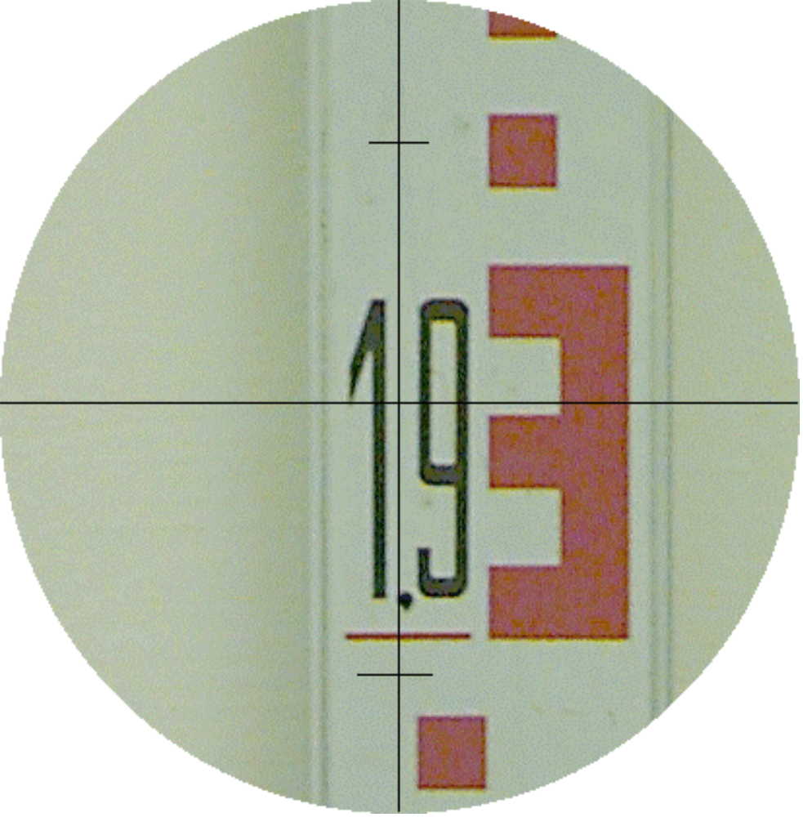
Reading an E-type levelling staff
The value is ?
Read value at
the
horizontal
cross hair
1.932
1.930
1.920
1.910
1.900

Slide 20
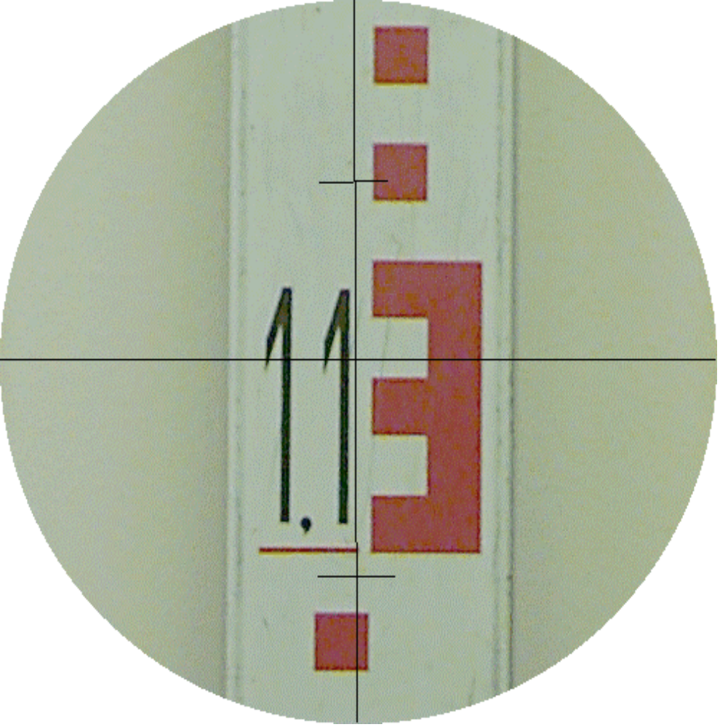
1.133
1.130
1.120
1.110
1.100

Slide 21
Introduction to Levelling
We have covered the following
What is meant by RL
The basics of an Instrument
known as a Level
Dumpy
Level
Tilting Level
Automatic Level
Digital Level
How to transfer RL s
Datums - OBM - TBM

Slide 22
It is necessary to practice with a real level and staff
Next week
Practical session - Meet at Survey store - 2nd Door on Left
inside main entrance
Collect - Level and Tripod
N.B. Please - ALWAYS GET YOURSELF ORGANISED BEFORE
ENTERING THE STORE i.e. pencils - notes - field books etc.
You can leave bags etc inside the survey store -
Carry out : Setting up an automatic level
Eliminating PARALLAX
Reading level staff
Reducing levels for given points

Slide 24
Levelling
HPC
HPC
BS
FS
BS
FS
RL C
RL A
RL B
C
A
B
(CP)
RL A is known
HPC =
RL A + BS
RL B =
HPC - FS
Now the RL B is known
So we can repeat the process
HPC =
RL B + BS
RL C =
HPC - FS
Generally : HPC = Known RL + Back Sight
Unknown RL = HPC - Fore Sight

Slide 25
Summary of Levelling Procedure
When the level has been set up we always start with a BS to
a point whose RL is known
- such as an OBM or a TBM
The last reading at any instrument position is always a FS
i.e.always end with a FS
Either the instrument moves or the staff moves -
never move both
We must always finish levelling at a point of known RL value
- such as an OBM or a TBM
always close your levelling

